Slide 1


IES FINAL GROUP PROJECT
Dhyan Bhaveshkumar Shah
Anastasios Bravakis
Chinmay Chhatrapalsing Rajput

Slide 2
Project Summary
This Project shows how we can create an ASP.NET Core web app with user data protected by authorization.
It displays a list of contacts that authenticated (registered) users have created.
There are three security groups:
Registered users can view all the approved data and can edit/delete their own data.
Managers can approve or reject contact data. Only approved contacts are visible to users.
Administrators can approve/reject and edit/delete any data.

Slide 3




About Our Group
Anastasios
Bravakis
Dhyan
Shah
Chinmay Rajput
Developer
& Database Manager
Developer & Presenter
Developer & Presenter

Slide 4
GitHub Repository Link
Project Link:
https://github.com/FIREFROST-11/ContactManager

Slide 5
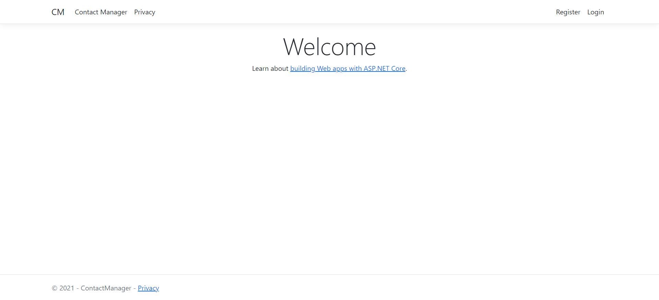
Welcome Page

Slide 6
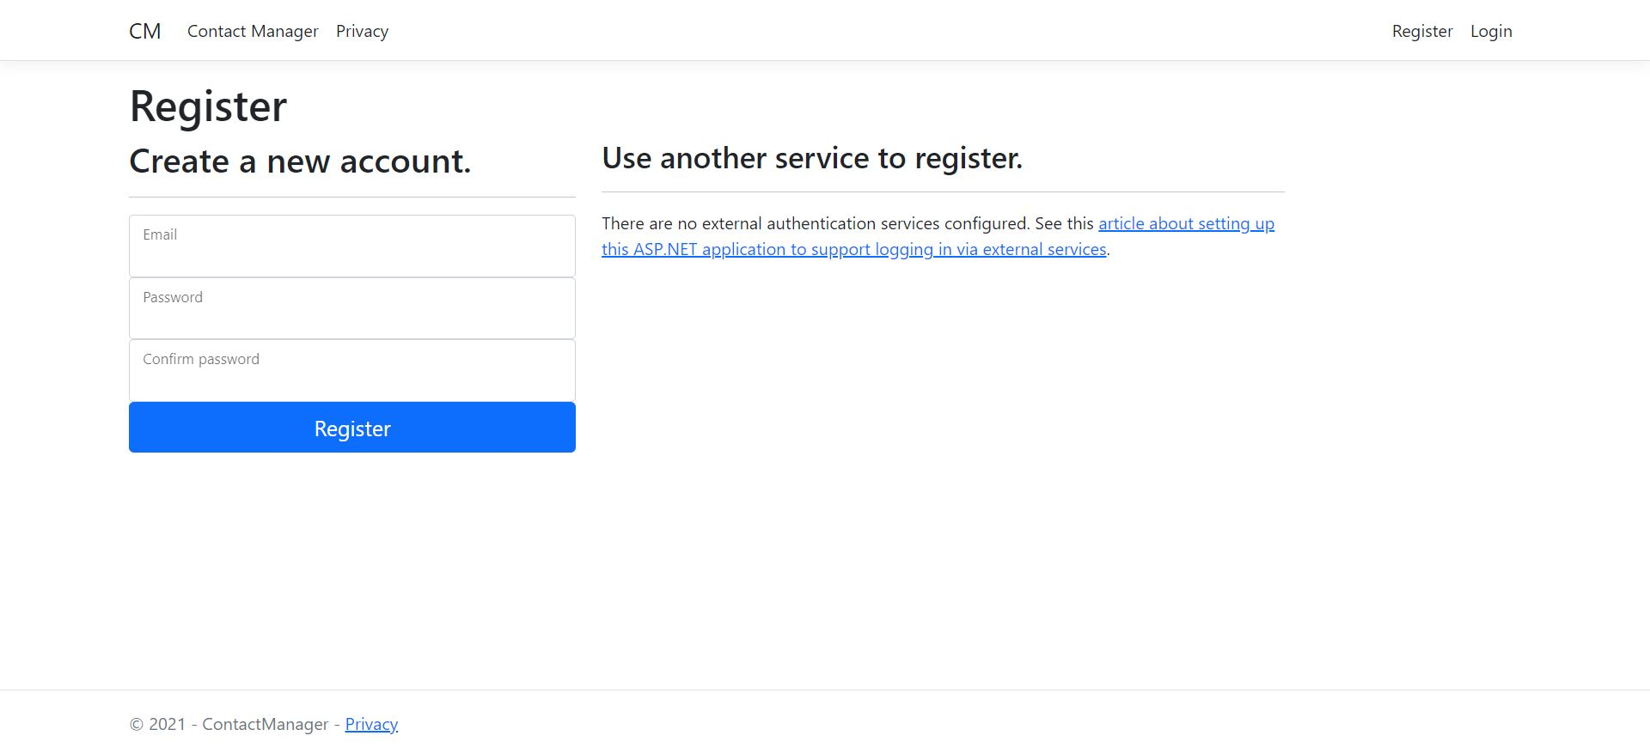
Register

Slide 7
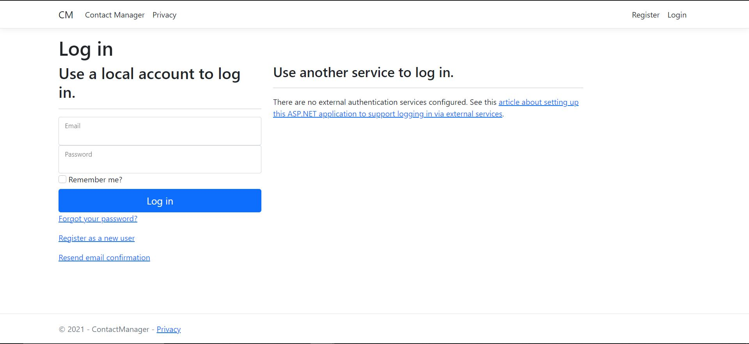
Login

Slide 8
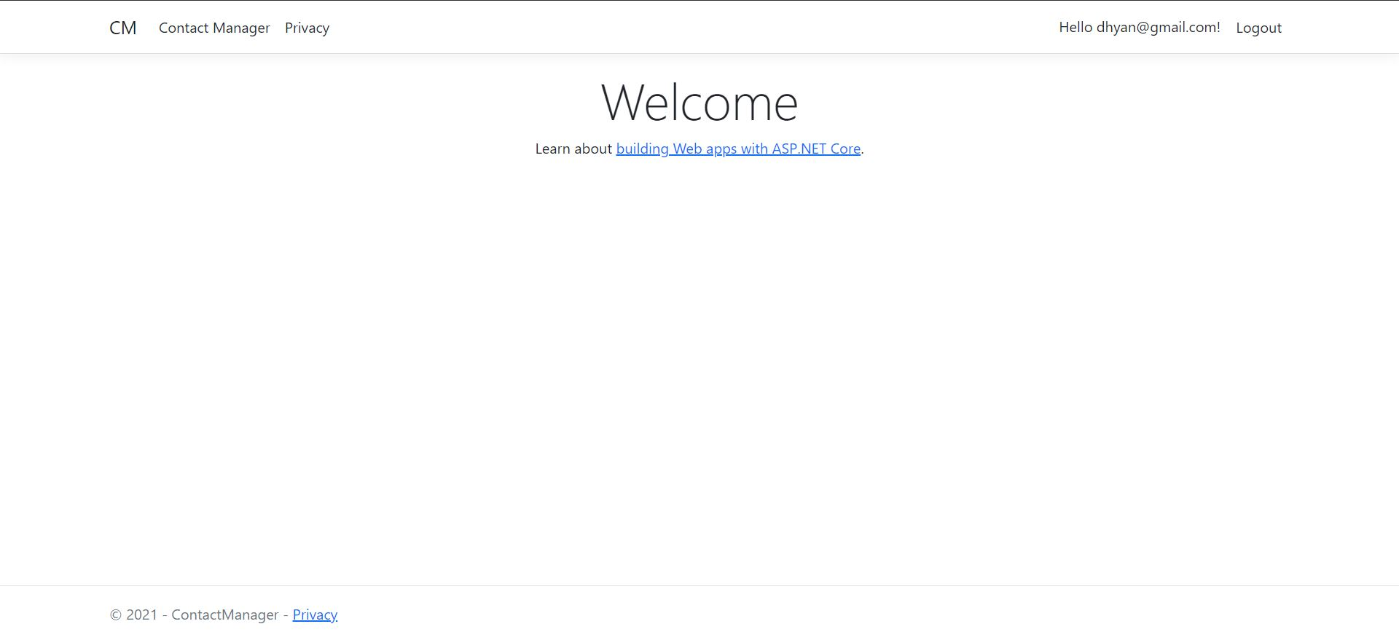
Login Welcome Page

Slide 9
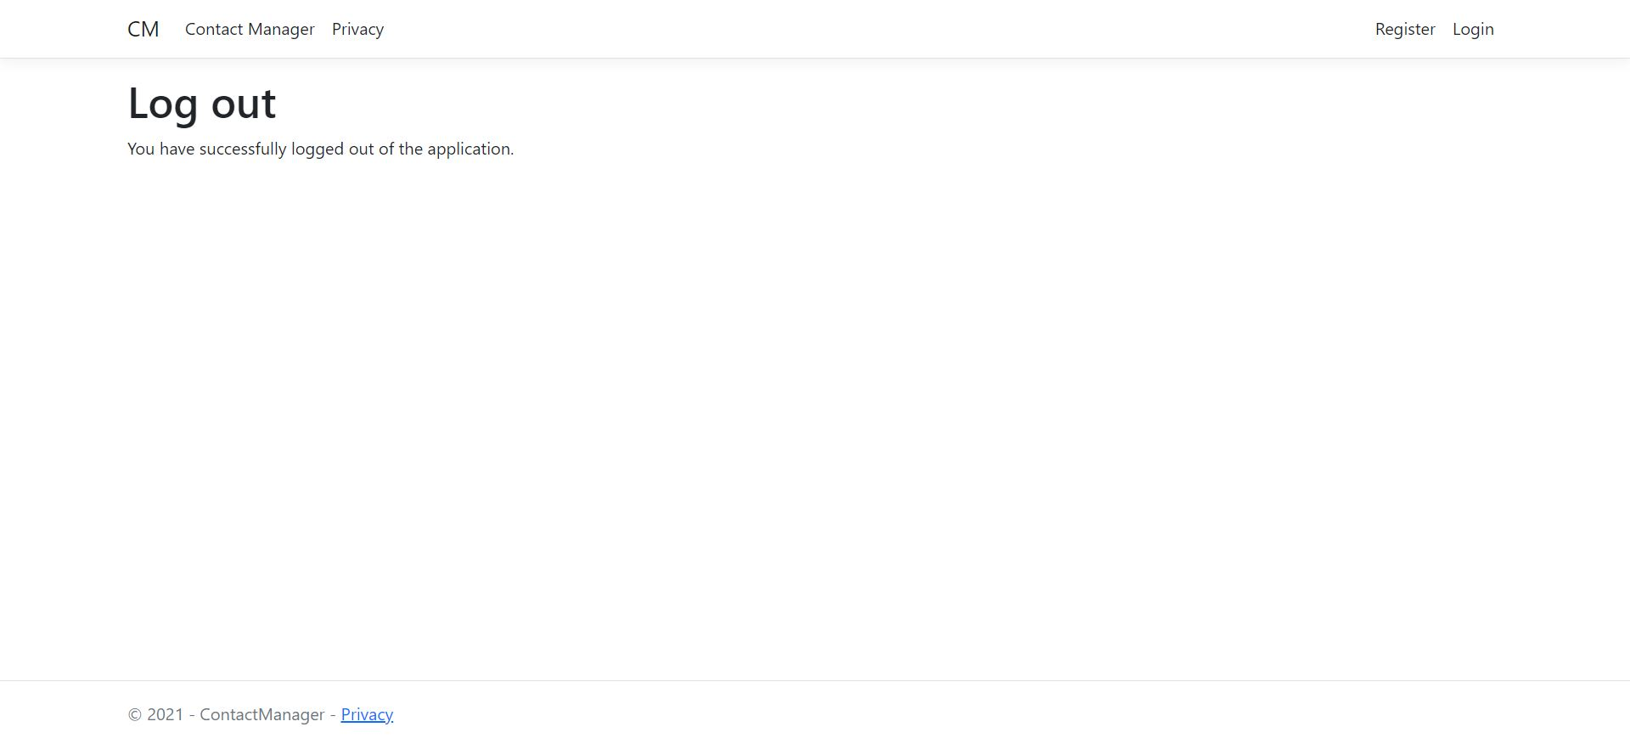
Log Out Page

Slide 10
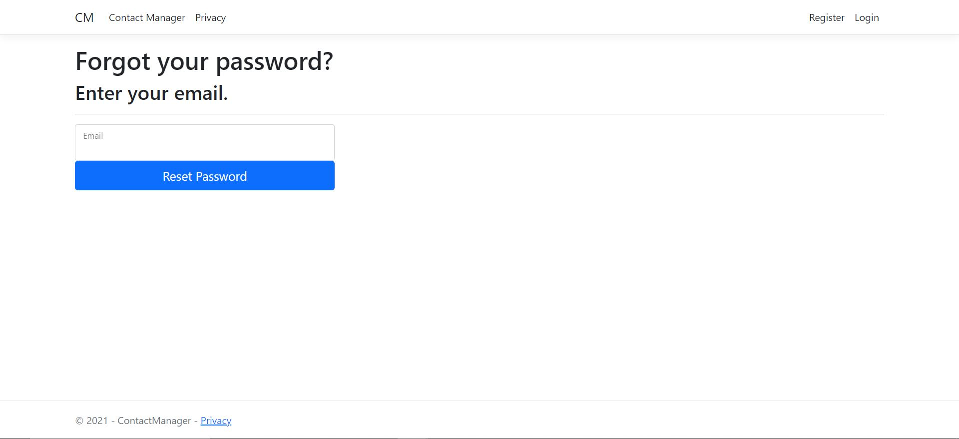
Forgot Password

Slide 11
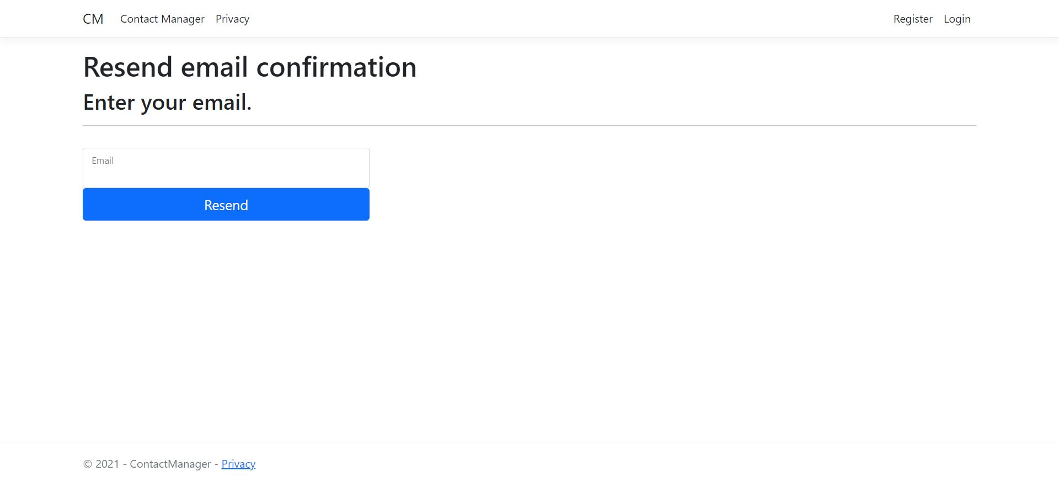
Resend Email Confirmation

Slide 12
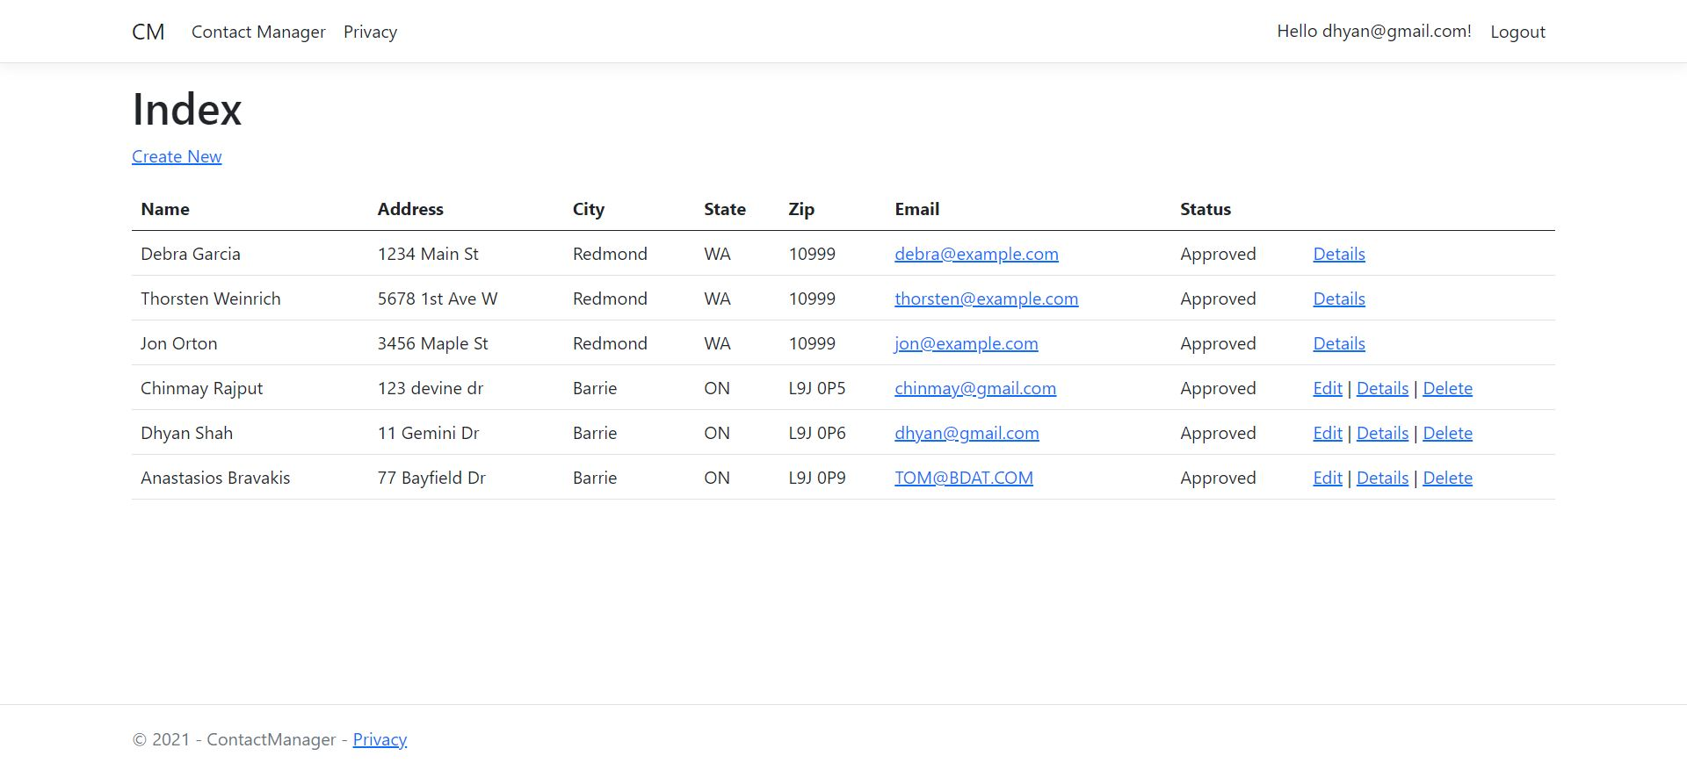
Contacts List

Slide 13
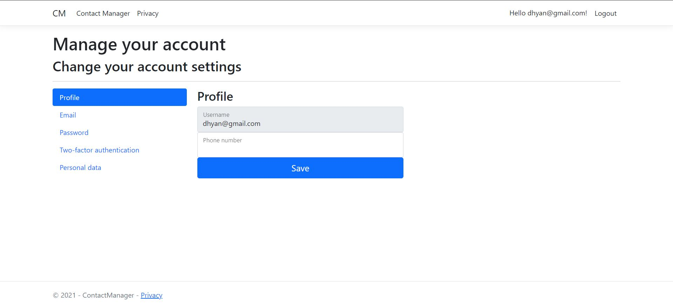
Profile Page

Slide 14
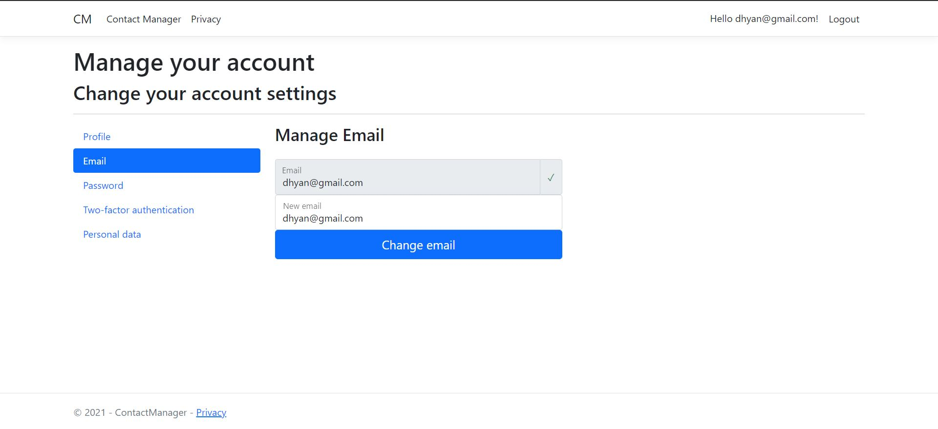
Profile Email Page

Slide 15
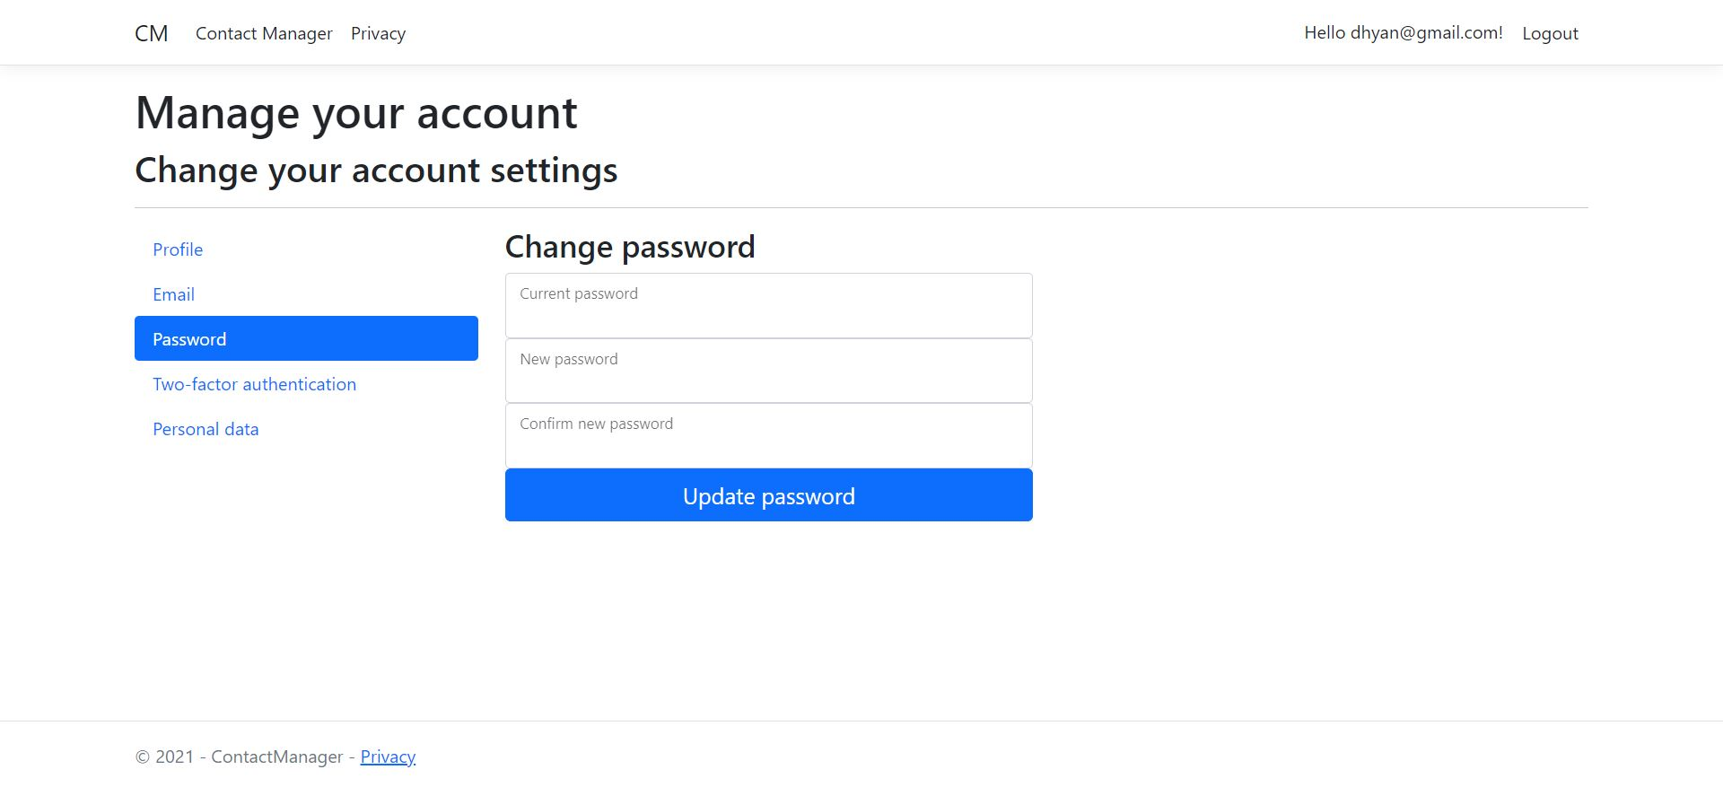
Manage Password

Slide 16
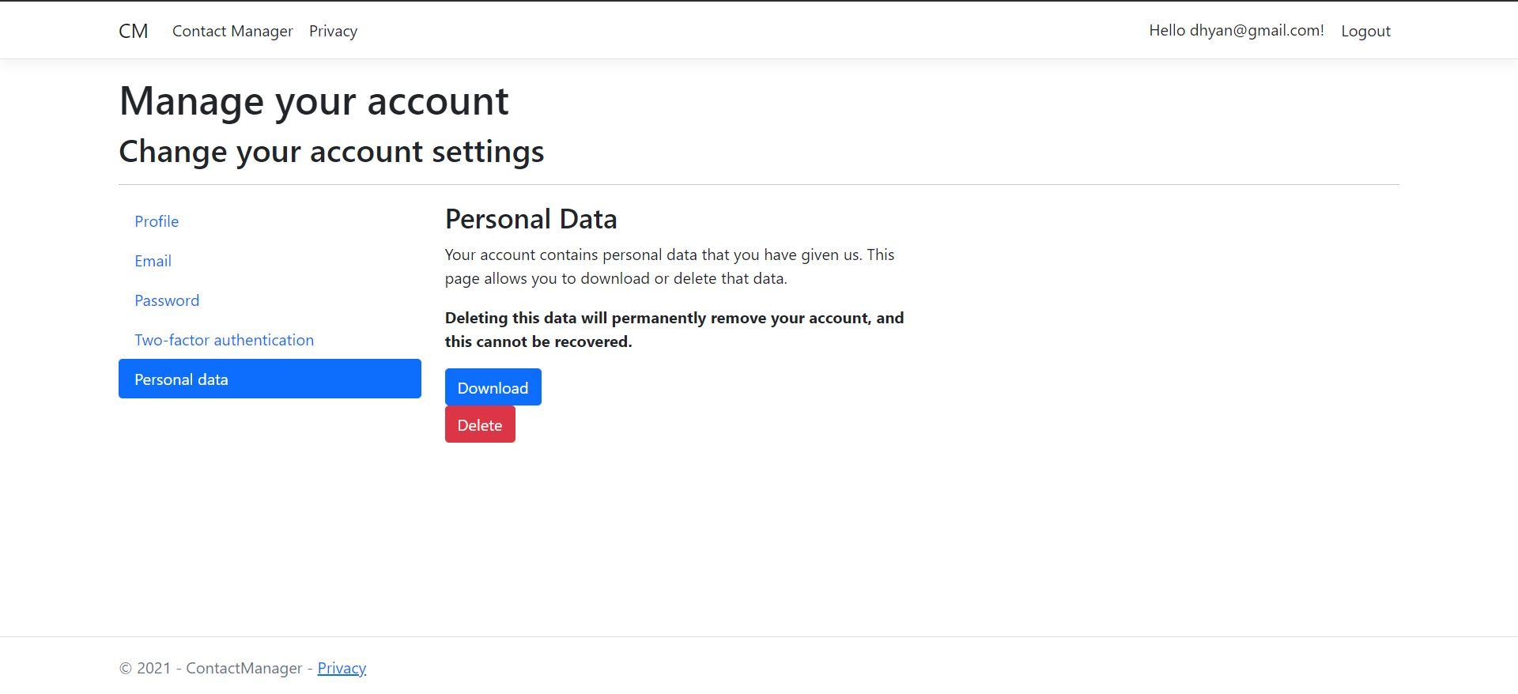
Personal Data

Slide 17
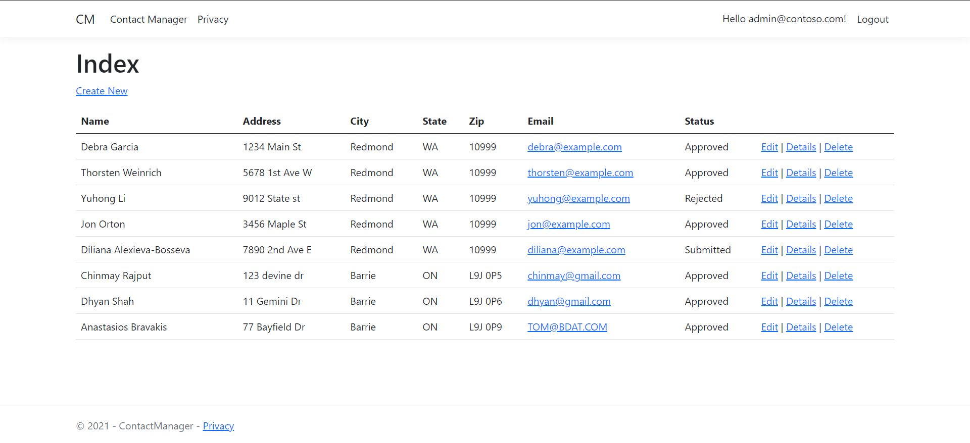
Admin Login

Slide 18
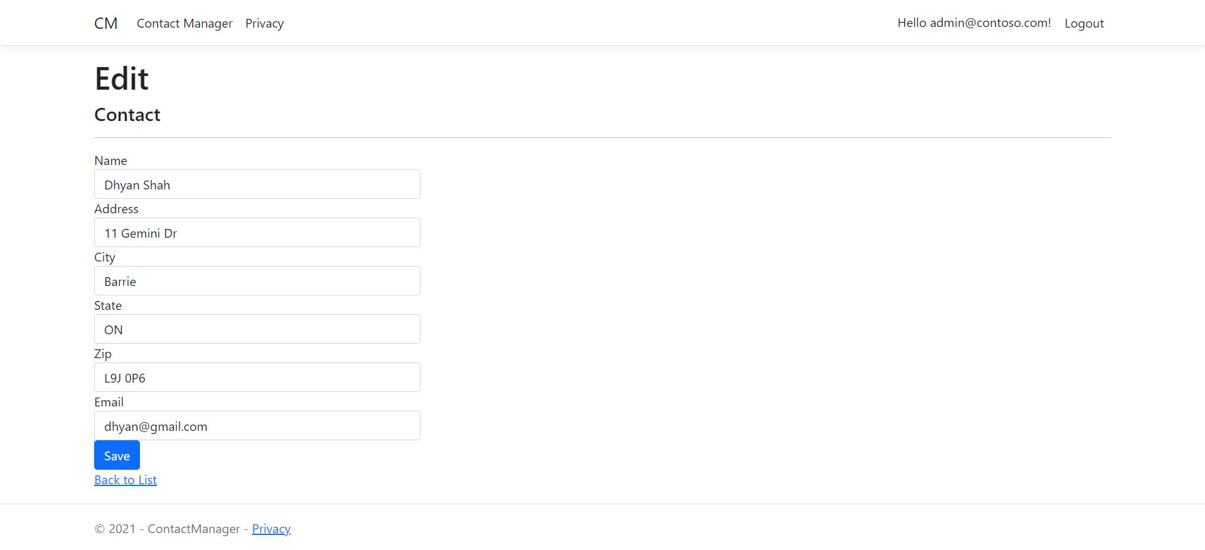
Admin Edit Contacts Page

Slide 19
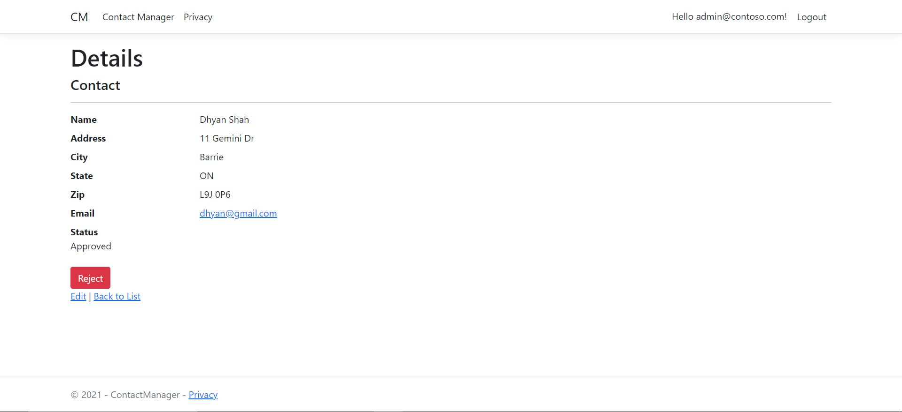
Admin Details Page

Slide 20
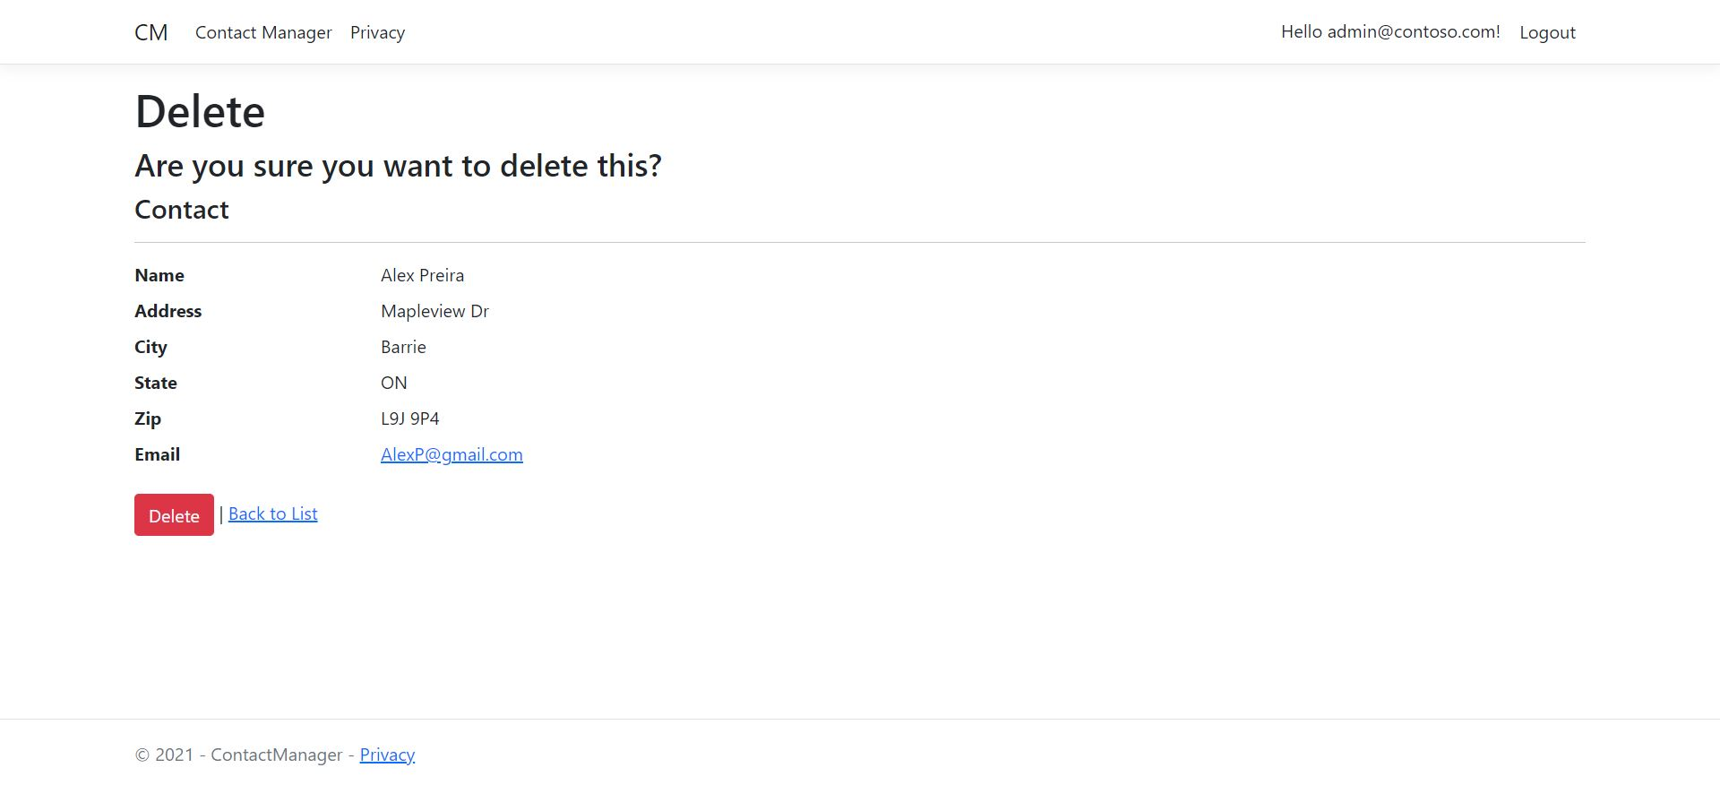
Admin Delete Contacts Page

Slide 21
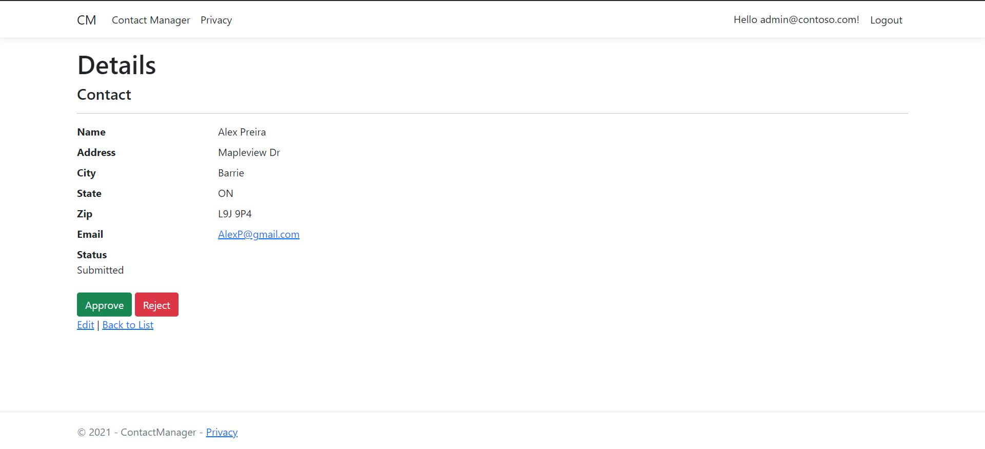
Admin New Contact Page

Slide 22
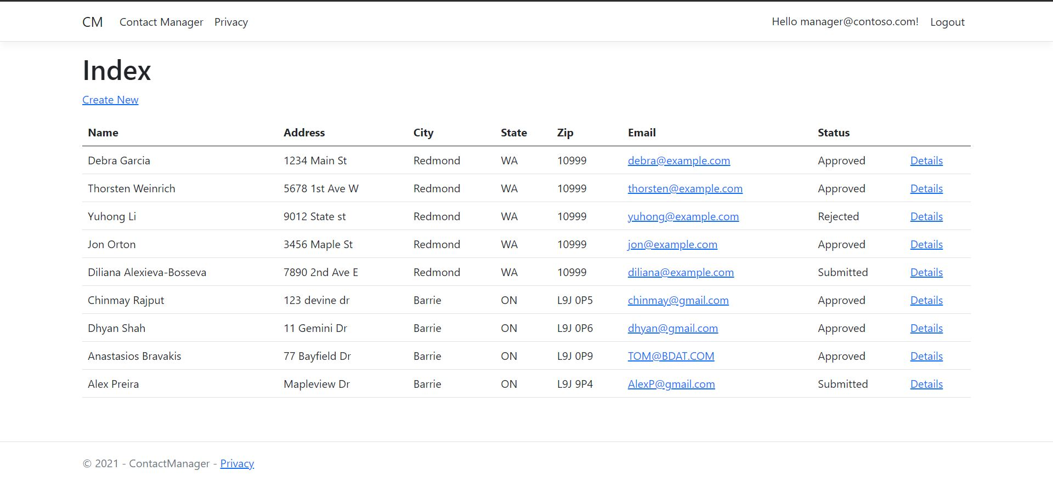
Manager Contacts Page

Slide 23
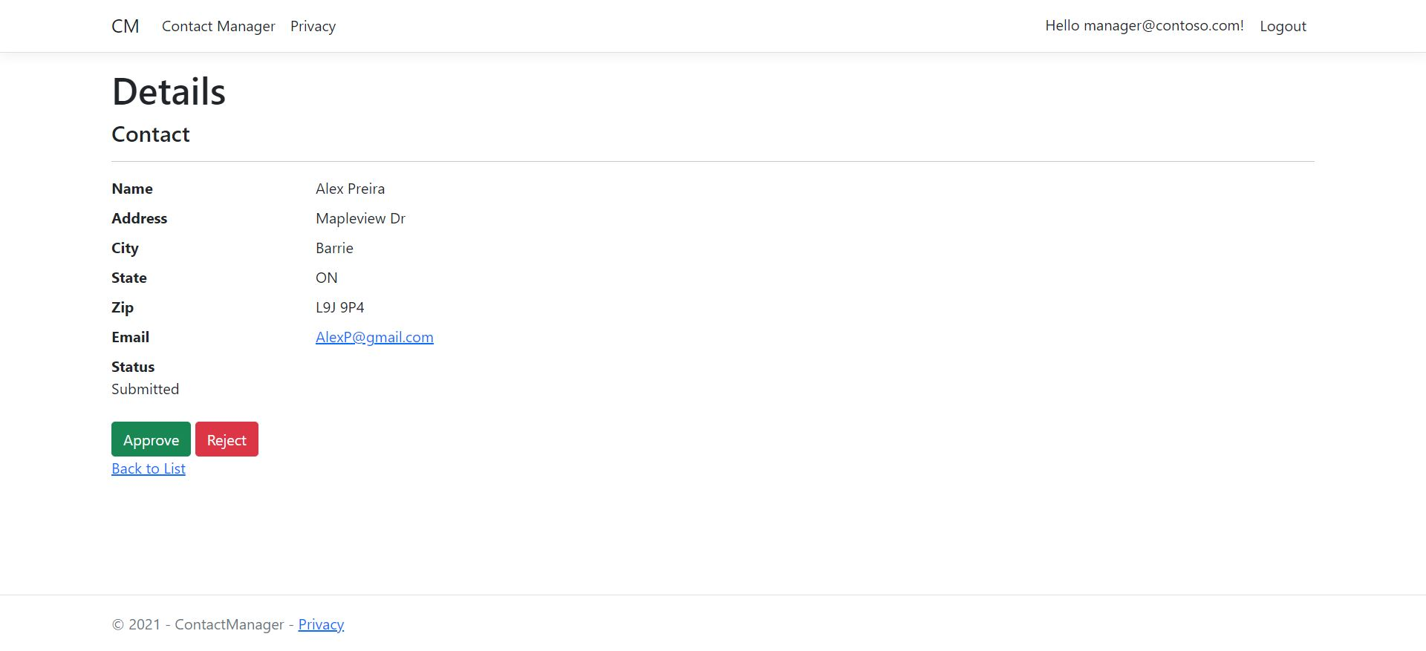
Manager Contacts Details

Slide 24
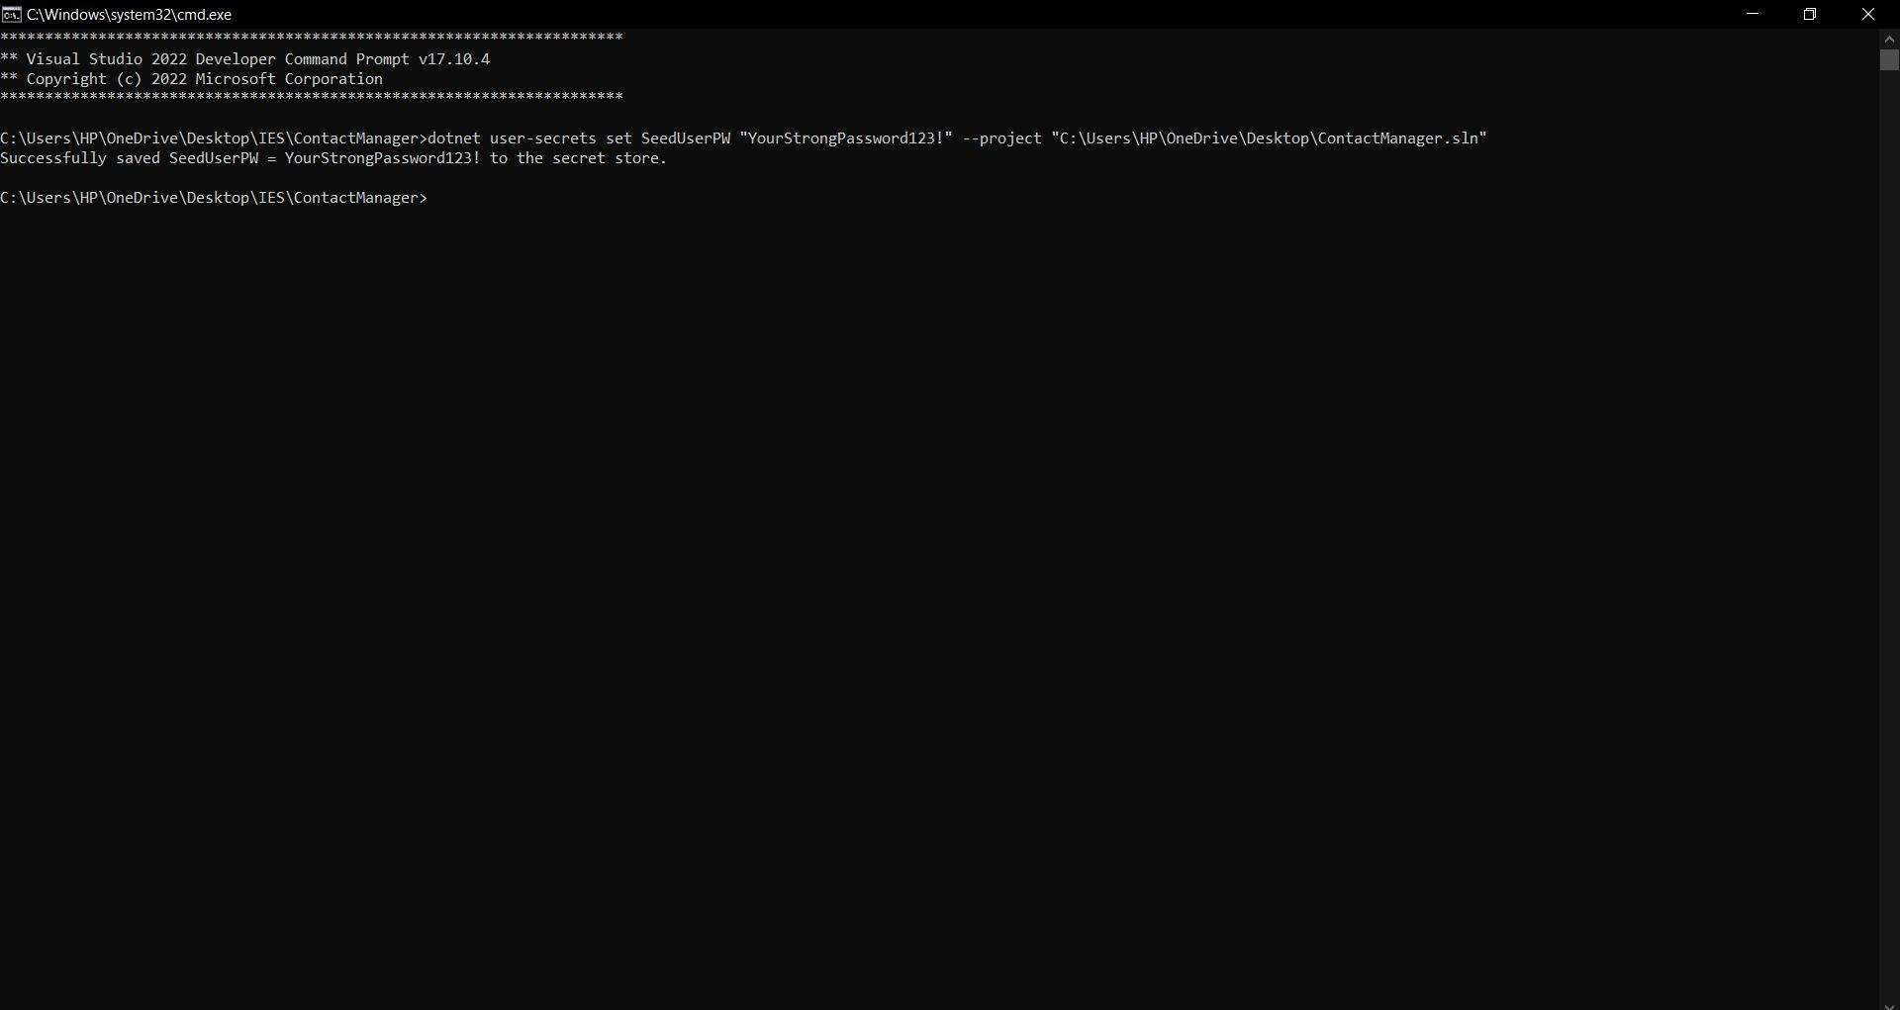
DB Set Password

Slide 25
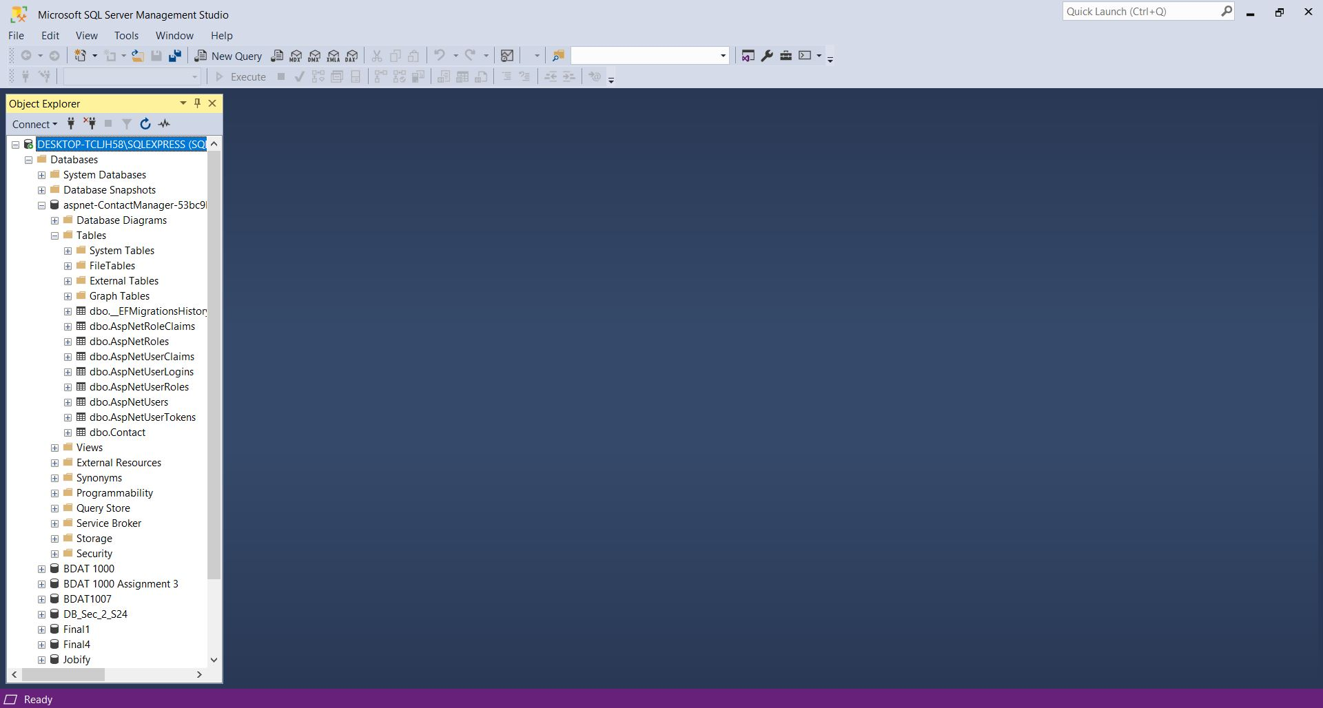
DB Tables

Slide 26
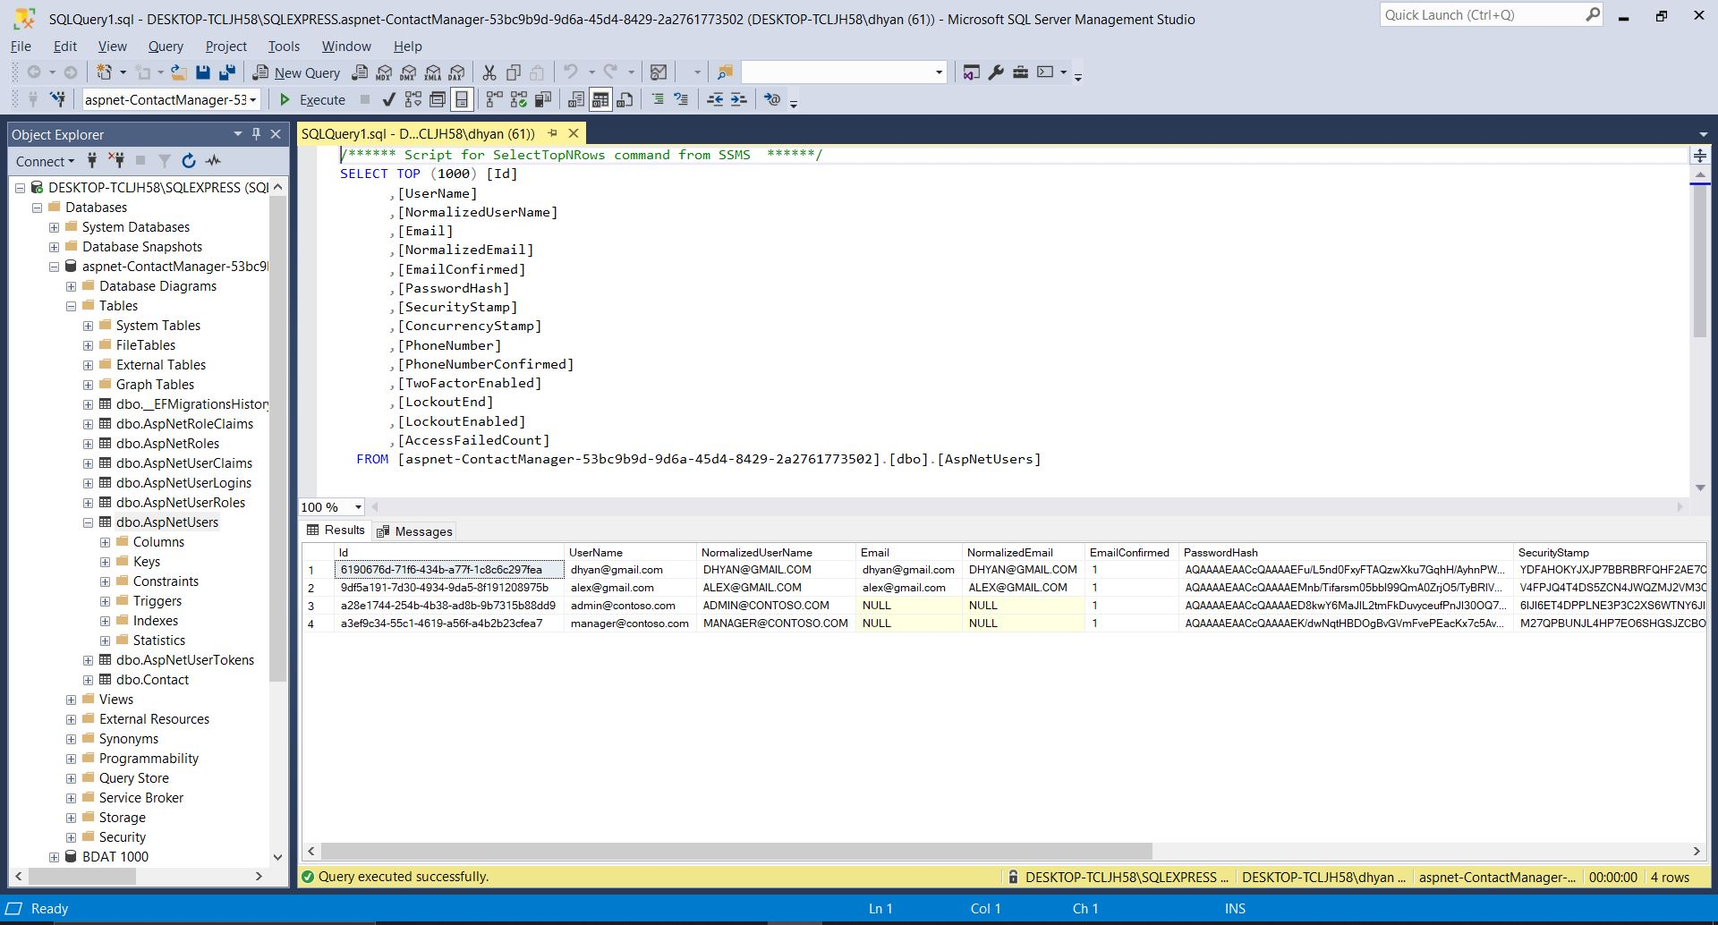
DB User List

Slide 27
Thank You

